Slide 1
THE POWER OF VISUALIZATION

Slide 2
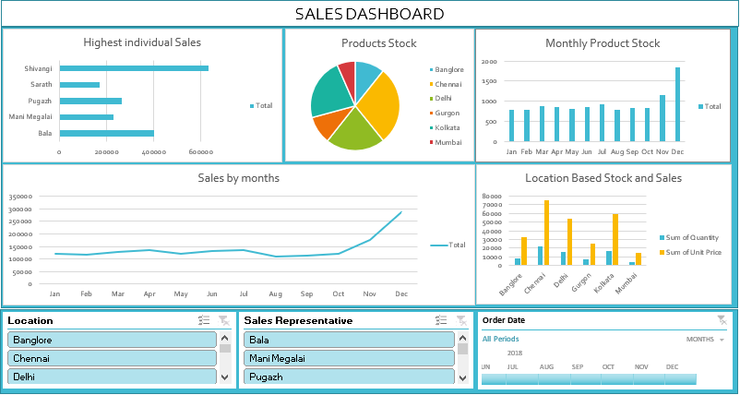
SALES PERFORMANCE

Slide 3
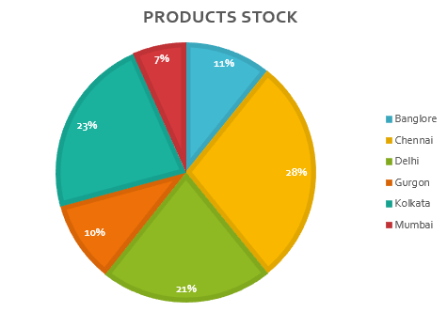
PIE CHART

Slide 4
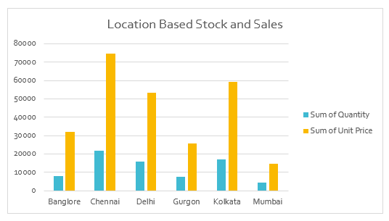
BAR CHART

Slide 5
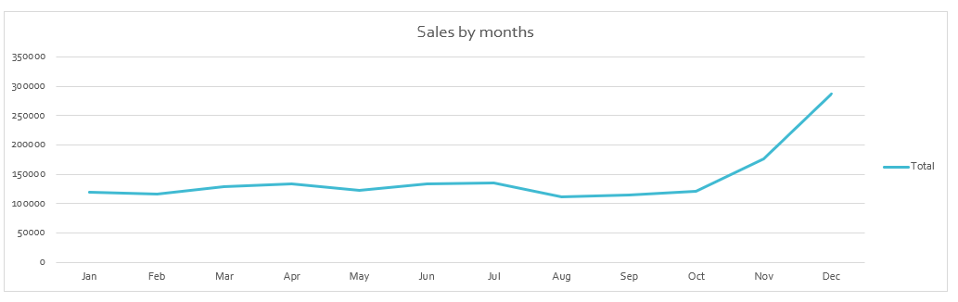
LINE CHART

Slide 6
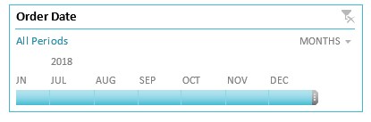
TIME STAMP

Slide 7
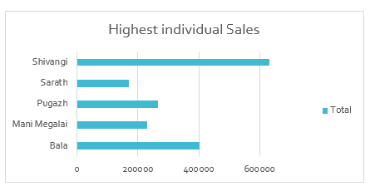
PIE CHART

Slide 8
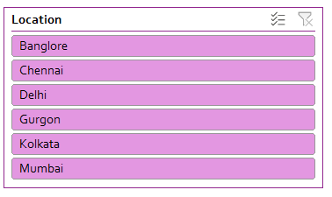
SLICER

Slide 9
THANK YOU
Let's collaborate to create something truly amazing together.

